Slide 1
Project Life Cycle and Organization
Lecture 2

Slide 2
Covered So Far
What is management
Why we need management
Responsibilities of Management
Project management
Software Project Management

Slide 3
Project Life Cycle and Organization
Project life cycle
Divide projects into phases to provide better management control with appropriate link to ongoing operations.
Project life cycle defines:
- What technical work to do in each phase.
- What deliverables are to be generated in each phase and how they are reviewed, verified and validated.
- Who is involved in each phase.
- How to control and approve each phase.
Project life cycle
Divide projects into phases to provide better management control with appropriate link to ongoing operations.
Project life cycle defines:
- What technical work to do in each phase.
- What deliverables are to be generated in each phase and how they are reviewed, verified and validated.
- Who is involved in each phase.
- How to control and approve each phase.

Slide 4
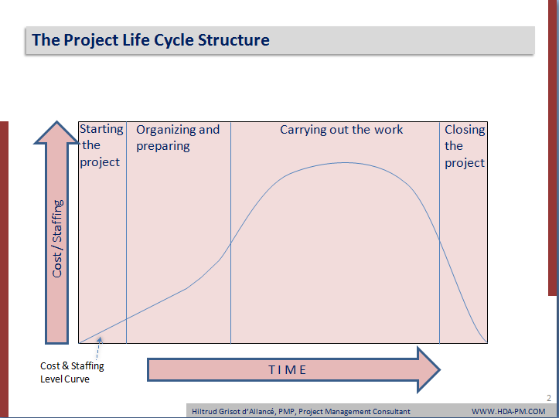
The Project Life Cycle Structure

Slide 5
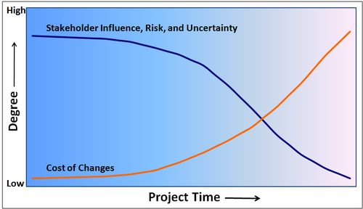
Characteristics of The Project Life Cycle

Slide 6
Project Phases
The completion and approval of one or more deliverables characterize a project phase.
For reason of size, complexity, level of risk, and cash flow constraints, project phases can be further subdivided into sub phases aligned with one or more specific deliverables for monitoring and control.
For each phase and sub phase, the project management processes can be applied.

Slide 7
More on Project Phases
In early phases of a project life cycle
  resource needs are usually lowest
  the level of uncertainty (risk) is highest
  project stakeholders have the greatest opportunity to influence the project
In middle phases of a project life cycle
  the certainty of completing a project improves
  more resources are needed
The final phase of a project life cycle focuses on
  ensuring that project requirements were met
  the sponsor approves completion of the project

Slide 8
Project life cycle and product life cycle
Product life cycle starts with the business plan, through ideas to product, ongoing operations and product divestment.
The project life cycle goes through a series of phases to create the product.

Slide 9
Organizational Culture
Project life cycle
Divide projects into phases to provide better management control with appropriate link to ongoing operations.
Project life cycle defines:
- What technical work to do in each phase.
- What deliverables are to be generated in each phase and how they are reviewed, verified and validated.
- Who is involved in each phase.
- How to control and approve each phase.
Organizational culture is a set of shared assumptions, values, and behaviors that characterize the functioning of an organization.
Many experts believe the underlying causes of many companies’ problems are not the structure or staff, but the culture.

Slide 10
Ten Characteristics of Organizational Culture
Project life cycle
Divide projects into phases to provide better management control with appropriate link to ongoing operations.
Project life cycle defines:
- What technical work to do in each phase.
- What deliverables are to be generated in each phase and how they are reviewed, verified and validated.
- Who is involved in each phase.
- How to control and approve each phase.
Member identity*
Group emphasis*
People focus
Unit integration*
Control
Risk tolerance*
Reward criteria*
Conflict tolerance*
Means-ends orientation
Open-systems focus*
*Project work is most successful in an organizational culture where these items are strong/high and other items are balanced.

Slide 11
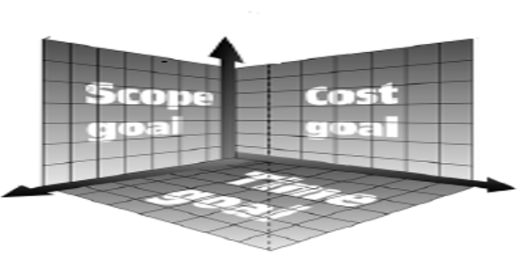
The Triple Constraint of Project
Management

Slide 12
Project Phases
Project life cycle
Divide projects into phases to provide better management control with appropriate link to ongoing operations.
Project life cycle defines:
- What technical work to do in each phase.
- What deliverables are to be generated in each phase and how they are reviewed, verified and validated.
- Who is involved in each phase.
- How to control and approve each phase.
Initiating phase
Planning phase
Executing phase
Controlling phase
Closing phase

Slide 13
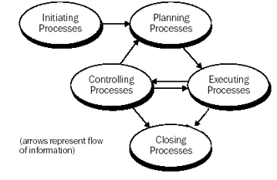
Links among processes (phases)

Slide 14


